Slide 1
CYBER CRIMES UNDERSTANDING AND MITIGATING DIGITAL THREATS

Slide 2

INTRODUCTION TO CYBER-CRIME
CYBERCRIME refers to illegal activities involving computers or networks.
Cyber-crimes have a significant financial and societal impact globally
Examples
Including Hacking,
Identity theft, and
Ransomware.

Slide 3
WHY STUDY CYBER-CRIME?
Studying Cybercrime is crucial to PROTECTING DATA, PREVENTING ATTACKS, ENHANCING CYBERSECURITY, UNDERSTANDING THREATS, SUPPORTING JUSTICE, ENSURING SAFETY, and adapting to evolving DIGITAL RISKS globally.
Cybercrime is multiplying with evolving technology.
Its impacts include financial losses, psychological harm, and societal disruption.
Prevention starts with understanding the threats.

Slide 4
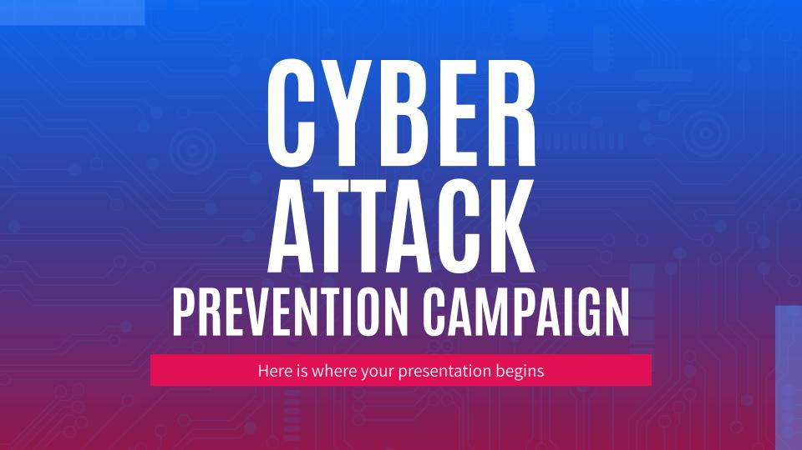
TYPES OF COMPUTER CRIMES

Slide 5
HACKING
Unauthorized access to systems to steal or manipulate data.
Methods: Exploiting vulnerabilities, brute-force attacks, social engineering.
Real-world Example: 2021 Colonial Pipeline ransomware attack.

Slide 6
IDENTITY THEFT
Stealing personal information for financial or personal gain.
Methods: Phishing, fake websites, or stolen credit cards.
Real-world Example: Equifax data breach (2017).

Slide 7
CYBER STALKING AND BULLYING
Using the internet to harass or intimidate someone
Platforms: Social media, email, messaging apps.
Real-world Example: Cases of harassment on platforms like Twitter or Instagram.

Slide 8
CYBER ESPIONAGE
Stealing sensitive data from organizations or governments.
Goal: Competitive advantage or sabotage.
Real-world Example: SolarWinds attack on US government agencies.

Slide 9
CYBER TERRORISM
Disrupting infrastructure for political or ideological reasons.
Targets: Power grids, financial institutions, or transportation systems.
Real-world Example: Attacks on Ukrainian power grids in 2015.

Slide 10

TYPES OF ATTACKS ON COMPUTER SYSTEMS

Slide 11
Malware Attacks
Includes viruses, ransomware, and spyware.
Goals: Corrupt, steal, or encrypt data.
Real-world Example: WannaCry ransomware attack (2017).

Slide 12
PHISHING ATTACKS
Fraudulent emails or websites to steal personal data.
Targets: Login credentials, and financial information.
Real-world Example: Google Docs phishing scam (2017).

Slide 13
DDOS ATTACKS
A Distributed Denial-of-service (DDoS) attack Overloads servers to disrupt services.
Tools: Botnets flooding traffic.
Real-world Example: Attack on Dyn DNS provider (2016).

Slide 14
MITM Attacks
Intercepting communications to steal or alter data.
Examples: Eavesdropping on unsecured Wi-Fi.
Real-world Example: Attack on Brazilian banks (2016).

Slide 15
SQL Injection
Injecting malicious code into websites or databases.
Goal: Extract sensitive information.
Real-world Example: British Airways breach (2018).

Slide 16
ARGOT OF COMPUTER CRIME
BOTNETS | DARK WEB | ZERO-DAY EXPLOIT
Networks of infected devices. | Hidden parts of the internet for illicit activities. | Attacks exploiting unknown vulnerabilities.

Slide 17
WHO ARE ONLINE PREDATORS?
Exploit vulnerable individuals online for exploitation.
TARGETS: Children, teenagers, or lonely adults.
PLATFORMS: Social media, chatrooms, or gaming platforms.

Slide 18
TACTICS OF ONLINE PREDATORS
Grooming victims by building trust over time.
Creating fake profiles to deceive.
Exploiting victims for financial, emotional, or physical gain.

Slide 19

THE FUTURE OF CRIME

Slide 20
PREDICTING FUTURE CRIMES
Use of predictive analytics to anticipate cyber threats.
Machine learning models to identify attack patterns.
Collaboration between governments and organizations for proactive measures.

Slide 21
THE FUTURE OF CYBER-CRIME
AI-powered phishing and hacking tools.
Exploiting vulnerabilities in IoT devices.
Deepfakes used for fraud or manipulation.

Slide 22
THANK
YOU

